Slide 1

Buck Converter for LED Driver in Industrial Lighting
Buck Converter Modeling
Voltage Mode Control & Stability Analysis
Student Names & ID’s:
Atahan KARAOĞLUOL 150722057
Mehmet Ali KAMALAK 150720062

Slide 2
Abstract
This project presents the design and simulation of a buck converter to drive a 24 V LED array from a 48 V DC bus using MATLAB/Simulink. The main objective is to achieve a well-regulated output with small ripple over a 1–5 A load range. A PI controller is designed using a voltage-mode small-signal model that includes the capacitor ESR, and the open-loop stability is evaluated with Bode plots. The final design achieves a phase margin of about 89.5° and a gain margin of about 8.7 dB. The dynamic performance under a 1 A to 5 A load transient is analysed using an average state-space Simulink model, showing acceptable voltage deviation and recovery time for industrial lighting applications.

Slide 3
Problem: In industrial lighting systems, LED arrays powered by a 48V DC busbar require precise voltage regulation. Voltage fluctuations shorten LED lifespan and cause flickering light intensity.
Tasks:
Input: 48V DC, Output: 24V DC
Ripple < %1
Stability: Phase Margin > 60° (For reliable operation)
Load Variance: Reliability 1A to 5A load transients.

Slide 4
Our Original Contribution
In this work our main contribution is to build a complete control-oriented model of the buck converter and to link it with a practical PI controller design. We derived and used a small-signal transfer function Gvd(s) that includes the effect of the output capacitor ESR, and based on this model we tuned a PI controller and checked the resulting Kp and Ki values both with Bode plots and with the closed-loop step response. We also implemented an average state-space Simulink model with inductor current and output voltage as states and used it to simulate a 1 A → 5 A load transient, so that the output voltage deviation and the recovery time could be evaluated. Finally, we organised the MATLAB code into a main script and two helper functions, which makes it easy to change the parameters and reuse the design for other operating conditions.

Slide 5
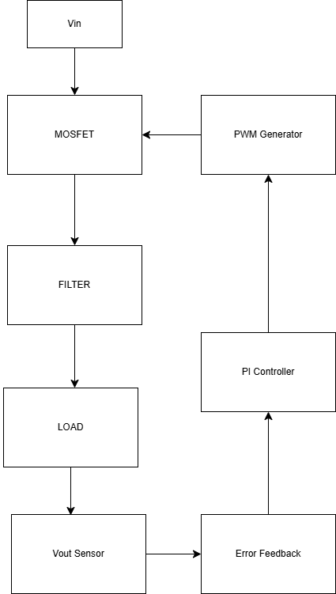
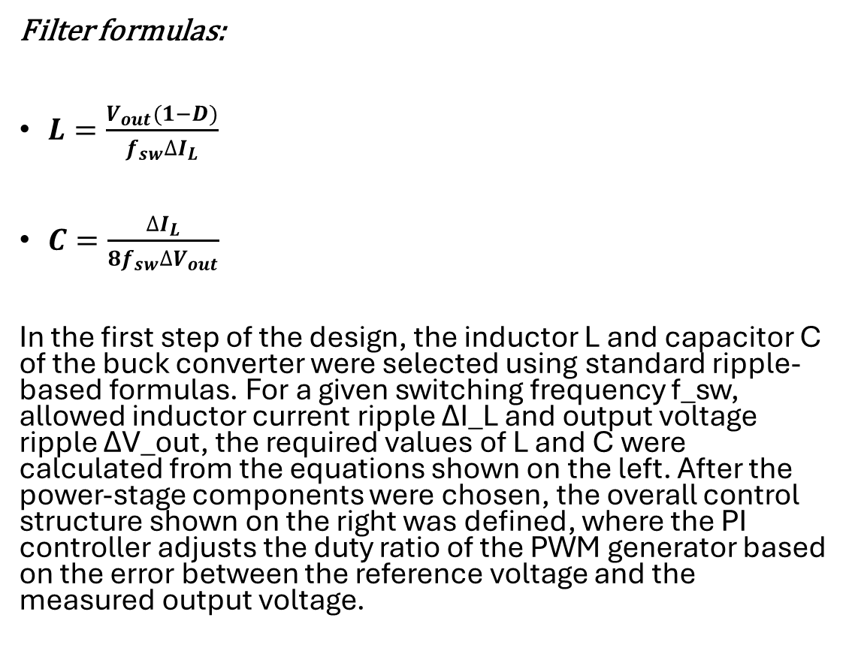
Methodology and Design
Filter formulas:
$L=\frac{V_{out}(1−D)}{f_{sw}∆I_{L}}$
$C=\frac{∆I_{L}}{8f_{sw}∆V_{out}}$
In the first step of the design, the inductor L and capacitor C of the buck converter were selected using standard ripple-based formulas. For a given switching frequency f_sw, allowed inductor current ripple ΔI_L and output voltage ripple ΔV_out, the required values of L and C were calculated from the equations shown on the left. After the power-stage components were chosen, the overall control structure shown on the right was defined, where the PI controller adjusts the duty ratio of the PWM generator based on the error between the reference voltage and the measured output voltage.
Overall control block diagram of the buck LED driver.

Slide 6
Methodology and Design – Flow Chart
Power Stage Design
Small-Signal Model
PI Controller Design
Frequency-Domain Check
MATLAB & Simulink Implementation
Simulation and Measurements
Evaluation & Conclusion
Start / Specifications

Slide 7
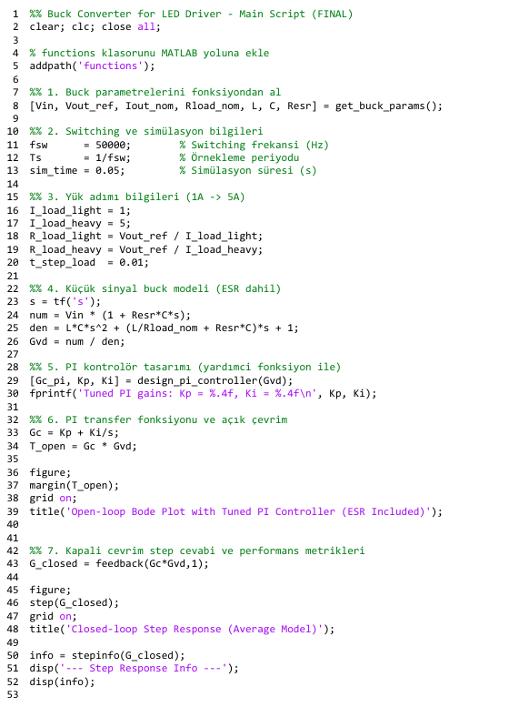
Matlab Implementation
The main_script.m file first sets up all converter parameters and load-step conditions by calling the helper function get_buck_params.m.
The small-signal control-to-output transfer function Gvd(s) of the buck converter is then constructed, including the effect of the output capacitor ESR.
Next, the PI controller gains Kp and Ki are obtained by calling design_pi_controller.m, which internally uses the pidtune command.
Finally, the script generates the open-loop Bode plot and the closed-loop step response, and uses the stepinfo function to print key performance metrics such as rise time, settling time and overshoot.

Slide 8
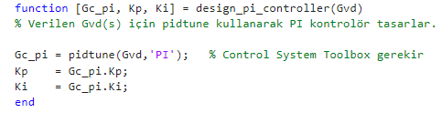
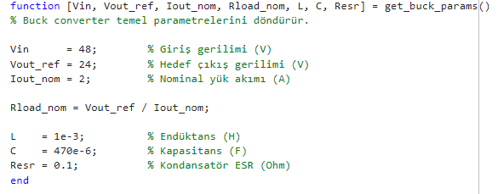
Functions Used
Helpful functions used in main script of the code.

Slide 9
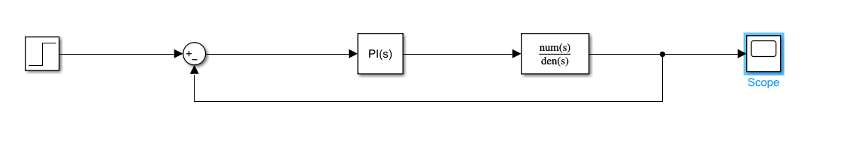
Simulink Implementation
Simulink model [3][4], represents the calculated Gvd(s) transfer function as a single LTI block. Verifies the PI controller performance against the theoretical linear model.

Slide 10
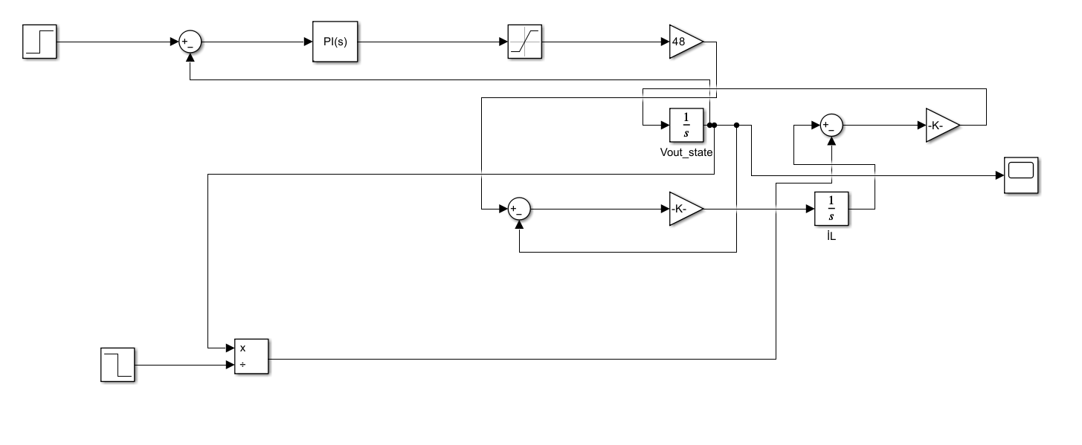
Simulink Implementation - Buck Average State Model
This schematic implements an averaged state-space model of the buck converter instead of explicit MOSFET/diode switching. The switching ripple is neglected, so the model provides a linear plant that is suitable for PI controller design and Bode-plot based stability analysis.
The two 1/s blocks represent the energy-storage elements: one integrates the inductor current and the other integrates the output capacitor voltage (Vout). The reference step is compared with the measured Vout to generate an error signal, which is processed by the PI controller. The controller output is limited between 0 and 1 by a saturation block and then multiplied by Vin = 48 V to obtain the averaged switch-node voltage.
A second step source is used to inject a load disturbance, allowing the transient response to a 1 A → 5 A load change to be evaluated with this average model.

Slide 11
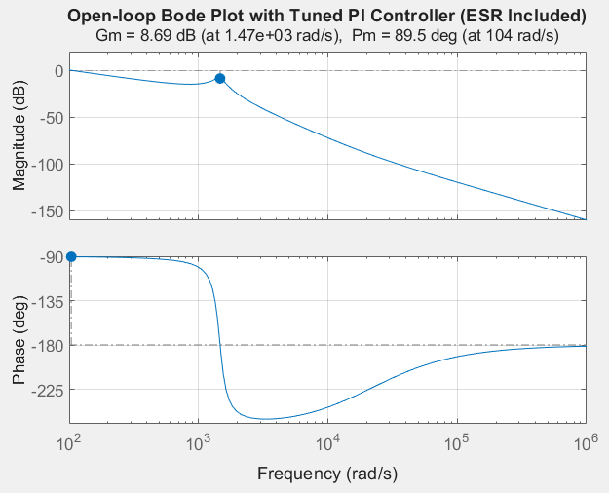
Results and Performance Metrics - Frequency Domain
The open-loop Bode plot of T_open(s) = Gc(s)·Gvd(s) shows that the designed PI controller gives a phase margin of about 89.5° and a gain margin of about 8.7 dB. The phase margin is well above the 60° target, so the system is robustly stable, while the gain margin is close to the 10 dB design goal.

Slide 12
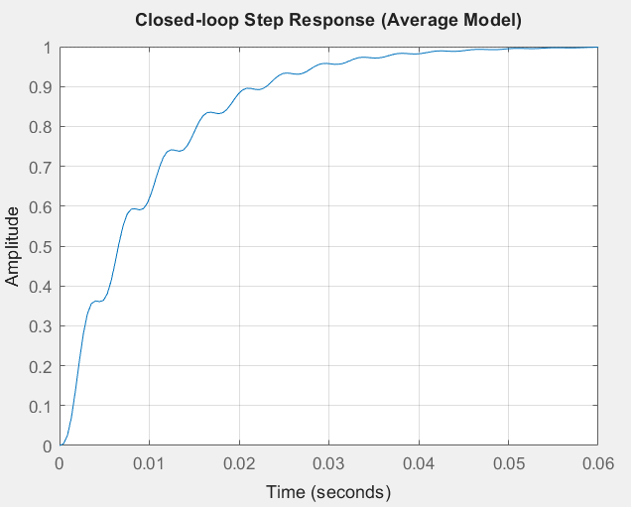
Results and Performance Metrics – Time Domain
For the closed-loop step response of the average model, the designed PI controller gives a rise time of about 21.5 ms and a settling time of about 37 ms with practically zero overshoot. The overshoot value reported by stepinfo is 0 %, and the steady-state value is very close to 1, which means that the controller removes the steady-state error under nominal conditions.

Slide 13
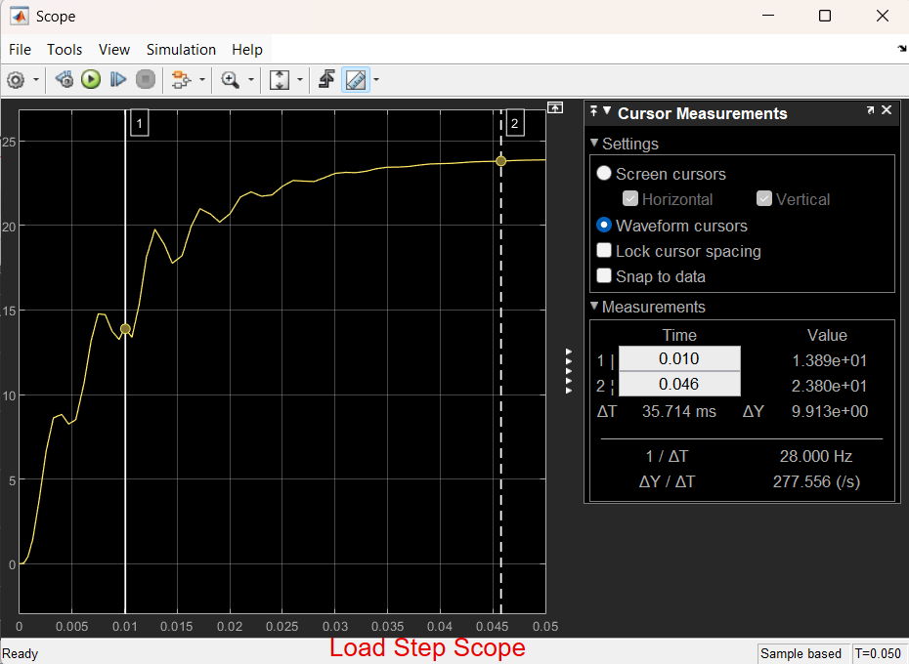
Results and Performance Metrics – Load Transient (1A -> 5A)
The average state-space Simulink model was used to test a 1 A → 5 A load step at t = 10 ms (R changes from 24 Ω to 4.8 Ω). The output voltage first rises towards the nominal 24 V level and then exhibits a transient when the load is increased. During this transient the voltage dips to approximately 13.9 V and then recovers back to around 24–25 V within roughly 36 ms. This shows that the PI controller keeps the LED driver stable under a severe load step, with a finite but acceptable voltage deviation and recovery time.
Load-step Vout minimum: ≈ 13.9
Load-step recovery time: ≈ 36 ms

Slide 14
Statement of AI Usage
In this project we used two AI tools as study helpers rather than as automatic solution generators. We consulted them to review the theory of buck converters, PI controller design and Bode-plot based stability margins, and we asked for alternative explanations when we was stuck. We also used them to suggest possible MATLAB/Simulink structures, to understand error messages and to get advice on how to organise the code in a cleaner way, for example by moving the parameter definitions and the PI design step into separate functions. All MATLAB scripts, functions and Simulink models were edited, run and checked by us, and the final parameter choices and design decisions were made manually. The figures used in the report (Bode plots, step responses and load-transient responses) come from simulations that we executed our, and we used AI only to help interpret the results and to polish the English wording of some parts of the text. The AI tools that supported this work are explicitly cited in the References section as sources [1] and [2].
AI tools used:
• ChatGPT (OpenAI, GPT-5.1 Thinking)
• Google Gemini

Slide 15
References
[1] OpenAI, “ChatGPT (GPT-5.1 Thinking),” large language model, accessed Nov.–Dec. 2025, online: https://chat.openai.com.
[2] Google, “Gemini,” large language model, accessed Nov.–Dec. 2025, online: https://gemini.google.com.
[3] MathWorks, “Buck Converter Voltage Control – MATLAB & Simulink Documentation.” [Online]. Available: https://www.mathworks.com/help/sps/ug/buck-converter-voltage-control.html (accessed Dec. 3, 2025).
[4] “Buck Converter Voltage Control [Video],” YouTube. [Online]. Available: https://www.youtube.com/watch?v=XcxzgpDFVP0 (accessed Dec. 3, 2025).

